Slide 1
Excel capstone - 2- 2
Supermarket sales
Submitted by
Shaik Reshma

Slide 2
Data Cleaning
From the data the date column is not in a good format
The date column contains both DMY and MDY Format
I have set the format as DMY by Text to columns , and selecting the format to be changed in the dialogue box of date format column

Slide 3
Data analyzing
From the date column I have created some columns like
Day
Month
Year
week name
Month name
And based on Total column I have created sales column which shows if it is a highest sales or a lowest sales

Slide 4
Data bars
From the data I have created Quantity bar column which displays the quantity as number of “*” . If the quantity is two then it displays ** next to the Quantity column
And created conditional formatting for rating column which shows
Green arrow for highest ratings
Yellow arrow for average ratings
And Red arrow for least ratings with bars

Slide 5
Data Visualizations
I have created pivot tables graphs and slicers
Payment ( represents the most preferred payment type by the customers )
Monthly wise gross income (which shows the month which has highest gross income)
City (sum of totals by city ,shows the city which has most sales)
Percentage of gender (by counts)
Most preferred products
Branch (which contains highest sales)

Slide 6
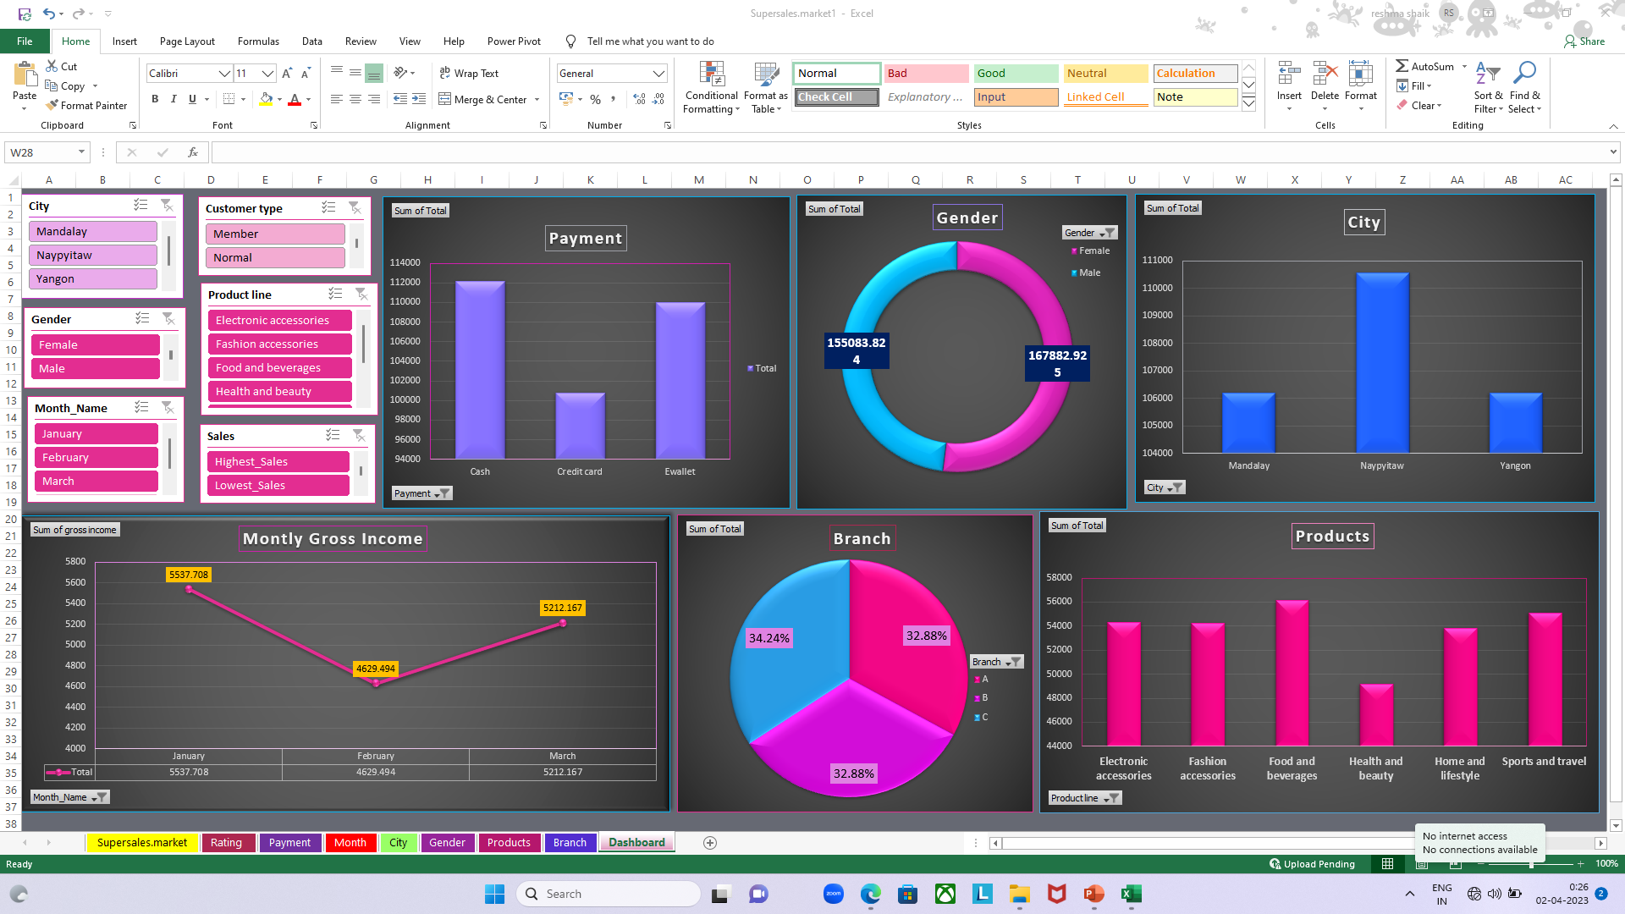
Dashboard

Slide 7
Conclusion
I have reported the connections between all the slicers so that if I click on one of the filter of any slicer , It will change the complete dashboard based on the selected category

